Slide 1
Trading Strategy Optimization Project
Jan Cichocki, Bertrand Bading, Krashawn Ray-el
GitHub Access

Slide 2
Executive Summary
Project Goal: Optimize trading strategies centered around the S&P 500.
Technical Analysis: Utilize SMA and RSI to understand market trends.
Collective Passion: Driven by a keen interest in financial markets.
Machine Learning: Commitment to using machine learning to improve trading strategies.

Slide 3
The Significance of the S&P 500
Market Snapshot: The S&P 500 reflects the U.S. economy's diversity, essential for assessing market sentiment.
Performance Benchmark: Acts as a vital benchmark for comparing individual or professional investment performance.
High Liquidity: Ensures tight bid-ask spreads for smoother transactions, beneficial for traders and investors.
Leverage Access: Futures markets allow for leveraging, increasing potential returns but also risks.
Hedging Opportunities: Futures can hedge against market downturns, protecting investments.
24/7 Market Accessibility: Enables quick reactions to global news, offering an advantage in fast-paced markets.

Slide 4
Finding The BEST S&P 500 Long & Short Windows
We created a loop to find the long and short windows that created the best accuracy.
We looked at all the windows that ended in 5 for both the short-term and long-term windows using AdaBoost and found the one with the best accuracy.
The results: Short Window 35 - Long Window 155

Slide 5
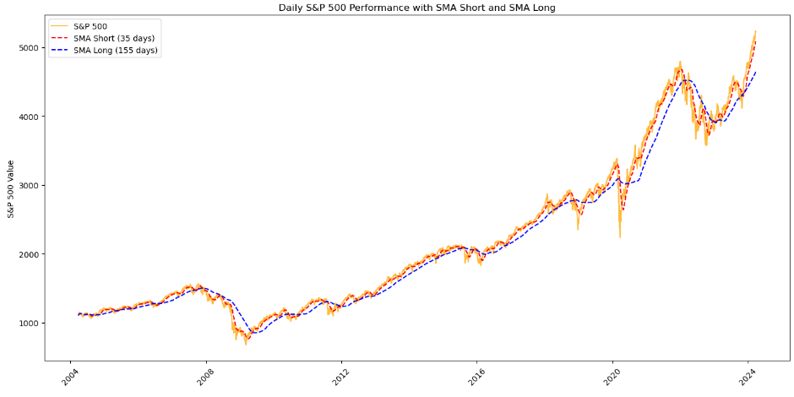
LONG-TERM VS. SHORT-TERm SMA Windows

Slide 6
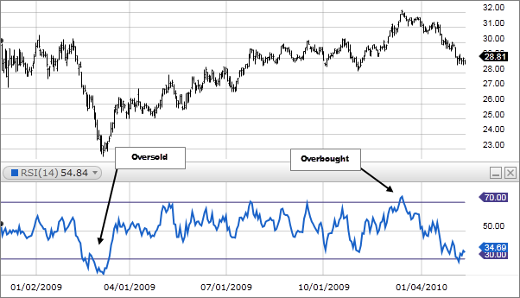
Improving the Strategy With RSI
Measurement Range: Ranges from 0 to 100.
Purpose: Identifies overbought (above 70) and oversold (below 30) conditions.
Function: Measures the speed of price movements.
Usage: Helps predict price corrections or reversals.

Slide 7
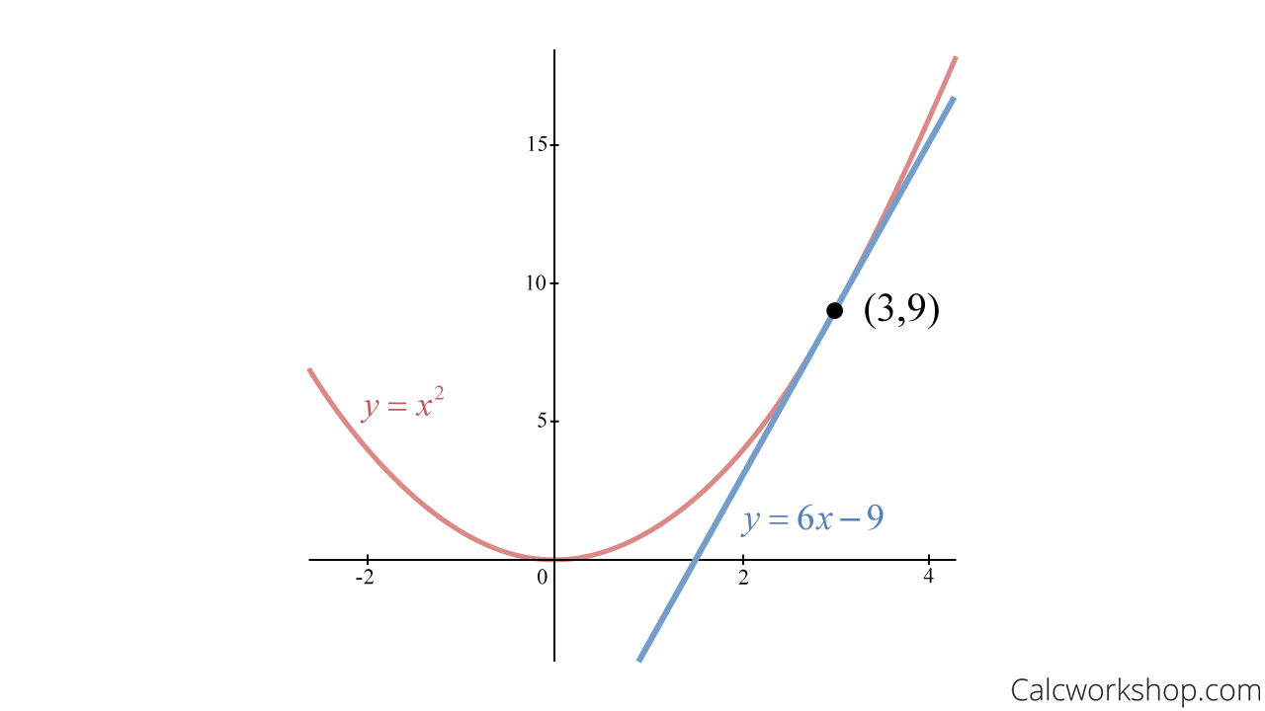
RSI slope As an indicator
If slope is positive and have a buy signal with our moving averages, that’s time to increase the position.
We ran 3-40 through AdaBoost using the SP500 Slope to see what would give us the best accuracy and it was
14
which is the default Wilder suggested in his book.

Slide 8
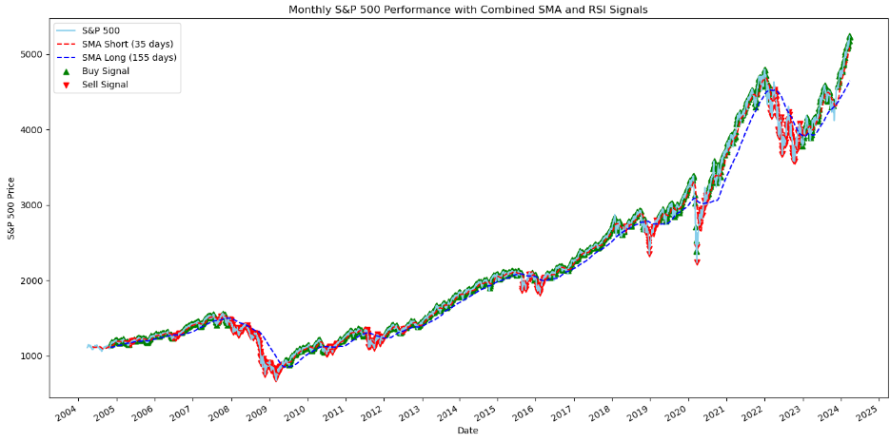
Hybrid simple moving average & RSI Strategy

Slide 9
Conclusion
Strategy
S&P 500
Collective Effort: Focused on simplifying trading strategies using the S&P 500.
Strategic Analysis: Employed SMAs and RSI to gain market insights.
AdaBoost Utilization: Enhanced strategy accuracy by identifying optimal combinations.
S&P 500's Role: Acts as a comprehensive market indicator and investment strategy guide.
Market Benefits: Offers liquidity, leverage, and hedging opportunities against volatilities.

